Slide 1
Exploring the Need for Certification of Digital Media Authenticity in the Era of Artwork Generated by Artificial Intelligence
Halleluia M. Zeyohannes
Mentor: Dr. Sashank Narain
Committee Member: Dr. Claire Lee
April 25, 2023

Slide 2
Motivations
Art Authentication: properly attributing authorship to an artist
Authenticating digital art is an ongoing challenge
Economic: Who profits from generative AI? How can it harm artists’ livelihood?
Legal: Who authors and owns generated works? How can they be used?
Ethical: Can AI art be used without harming living artists? Will generators replace artists?

Slide 3
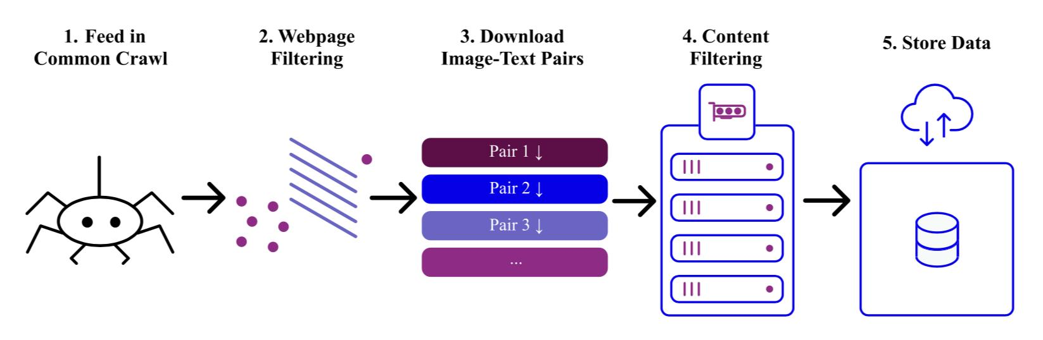
How AI Image Generators Work
Training Data:
Require massive datasets of images, text
LAION-5B: Largest publicly accessible dataset of Contrastive Language–Image Pre-training (CLIP) filtered image-text pairs: indexes nearly six billion pairs
< Overview of LAION-5B data collection process [1]
Notes:
Training:
Gathering large enough datasets for AI image generators, especially text-to-image generators, is crucial yet time consuming. However, curating larger datasets is one way to improve capabilties in newer models~\cite{s.farooqui}. Used by some of the most popular art generators, the largest publicly accessible dataset of Contrastive Language–Image Pre-training (CLIP) filtered image-text pairs is LAION-5B, produced by German non-profit organization LAION in efforts to promote machine learning (ML) research and application development~\cite{r.b}. This dataset, indexing nearly six billion pairs, was gathered by scraping the Internet through the Common Crawl, a public web archive, and filtering the images and their associated atl-text~\cite{c.s.laion5b}.
Algorithm:
AI image generators belong to the generative class of machine learning models that are trained on large sets of data, which can include text, images, videos, and audio, to then produce new data based on what it has learned. Generators have evolved over time from autoencoders, to generative adversarial networks (GANs), to diffusion models. Many popular art generators today are diffusion models; they methodologically destroy the data they train on using a forward diffusion process to introduce noise to images then learn to recover the data and its structure using a reverse diffusion process~\cite{j.s-d., v.m.}. This reverse diffusion process introduces variable outputs that allow AI image generators to create a near infinite number of possibilities, particularly when they are trained with massive datasets.

Slide 4
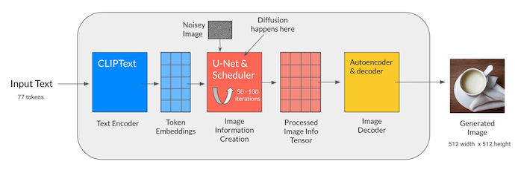
How AI Image Generators Work
Algorithm:
Generative class of machine learning models
Evolved over time from autoencoders, to generative adversarial networks (GANs), to diffusion models.
Many popular art generators today are diffusion models
Use a forward diffusion process then learn to recover the data with reverse diffusion process
Stable Diffusion Architecture[2] >
Notes:
Training:
Gathering large enough datasets for AI image generators, especially text-to-image generators, is crucial yet time consuming. However, curating larger datasets is one way to improve capabilties in newer models~\cite{s.farooqui}. Used by some of the most popular art generators, the largest publicly accessible dataset of Contrastive Language–Image Pre-training (CLIP) filtered image-text pairs is LAION-5B, produced by German non-profit organization LAION in efforts to promote machine learning (ML) research and application development~\cite{r.b}. This dataset, indexing nearly six billion pairs, was gathered by scraping the Internet through the Common Crawl, a public web archive, and filtering the images and their associated atl-text~\cite{c.s.laion5b}.
Algorithm:
AI image generators belong to the generative class of machine learning models that are trained on large sets of data, which can include text, images, videos, and audio, to then produce new data based on what it has learned. Generators have evolved over time from autoencoders, to generative adversarial networks (GANs), to diffusion models. Many popular art generators today are diffusion models; they methodologically destroy the data they train on using a forward diffusion process to introduce noise to images then learn to recover the data and its structure using a reverse diffusion process~\cite{j.s-d., v.m.}. This reverse diffusion process introduces variable outputs that allow AI image generators to create a near infinite number of possibilities, particularly when they are trained with massive datasets.

Slide 5
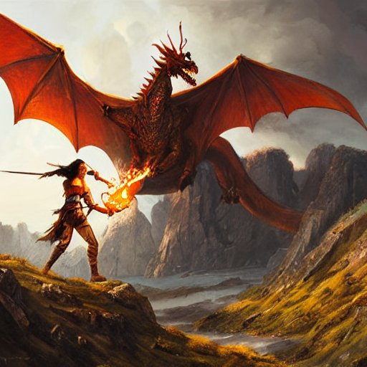
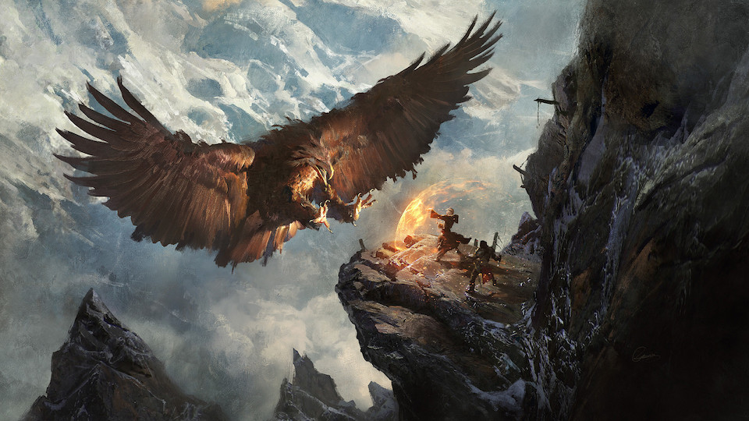
Concerns with AI Image Generators: IP Infringement
Greg Rutkowski: known for using traditional painting techniques to create distinct, fantasy landscape scenes
Two ongoing lawsuits: Getty Images filed against Stability AI for use of stock photography without proper licensing and a class action filed by lawyers for artists against Stability AI, Midjourney, and DeviantArt
< Rutkowski’s Secret Pass - Eagle’s Nest (2017) [3]
Image generated by Stable Diffusion > using a prompt with Rutkowski’s name

Slide 6
Concerns with AI Image Generators: Deterioration of Reputation
Artist styles are distinct and recognizable once attached to a name
Prompts using artist names can generate images that may lead people to assume authorship
Rutkowski’s name is associated with many images he had zero contribution to
Sarah Andersen: “his name is no longer attached to just his own work, but … a slew of imitations of varying quality that he hasn’t approved …[confusing] clients, and … [muddying his] consistent and precise output” [4]

Slide 7
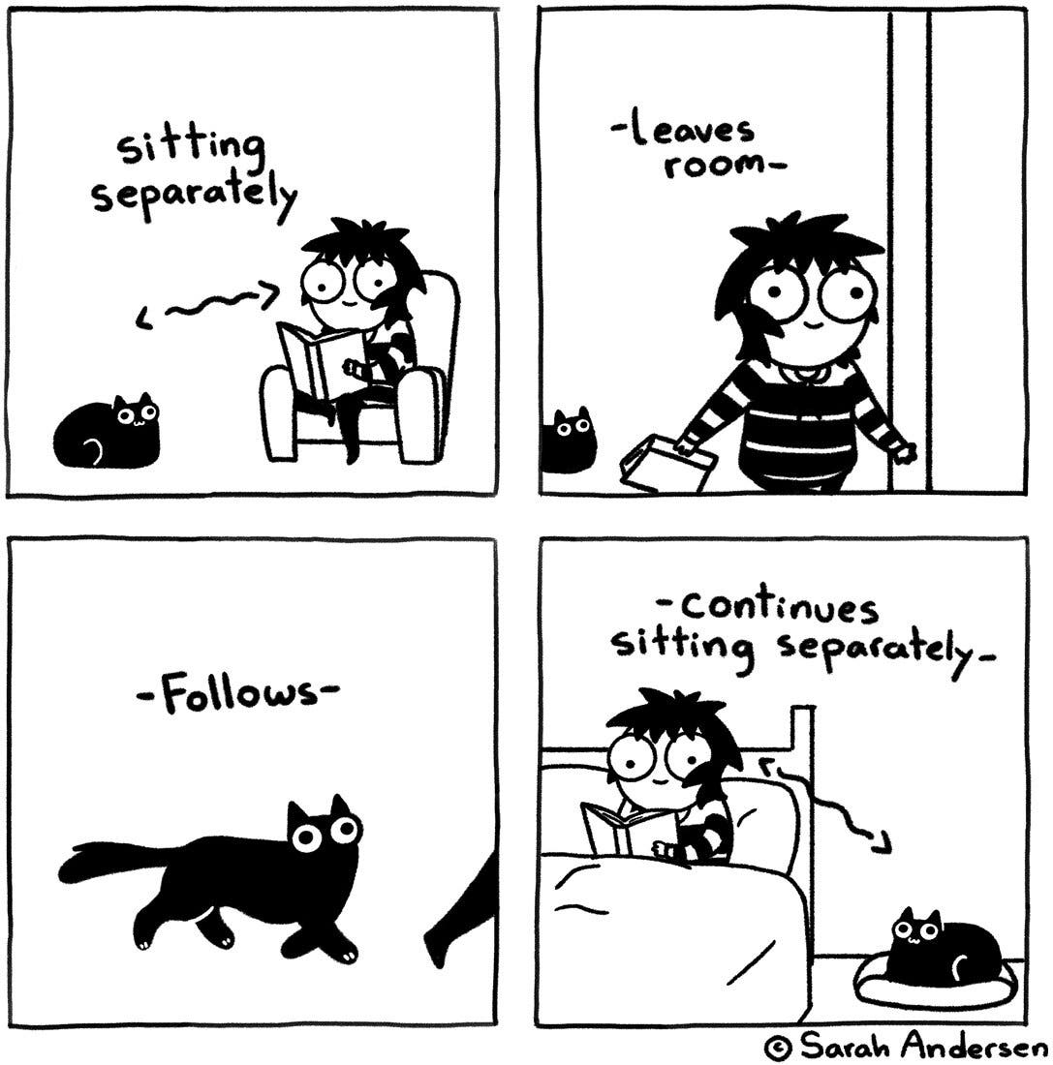
Concerns with AI Image Generators: Loss of Profit from Use of AIs
Artists are not properly credited or given compensation for their works that end up used by generative AI but many generators require payment to use
Loss of potential audience and clientele ⇒ Reduction in available jobs(commission or wage)
If this prediction is true, the earning potential is significantly cut unless they can keep up with or outpace AIs in terms of creative innovation.
< Example of Sarah Andersen’s semi-autobiographical comics [5]

Slide 8
Current Legal Boundaries for Use of Copyrighted Works
Exclusive rights for copyright owners: reproduction, creation of derivative works, distribution of copies, displaying the work, and authorizing others to use them
Only exception here is Fair Use
Made-For-Hire gives authorship/ownership to an employer or someone besides an artist when there is a legal agreement for a commission
United States Copyright Office passed a statement of policy effective March 16, 2023: copyrights are only granted to works with meaningful creative input from a human, i.e. purely generated works are not copyrightable
Notes:
Of the many questions that AI image generators raise up, the most pressing are of authorship and ownership for generated works. The United States' copyright law provides copyright owners several exclusive rights; relative to artworks, these rights include reproduction, creation of derivative works, distribution of copies, displaying the work, and authorizing others to use them, though this varies based statutory limitations~\cite{gen.copyright}. For creatives, a prominent exception is fair use, which allows a person to use a copyrighted work without the copyright owners permission as long as their use does not infringe upon the exclusive rights. Additionally, anyone can use works in the public domain, which are no longer copyrighted or can not have a copyright.
Recently, the United States Copyright Office (USCO) passed a statement of policy effective March 16, 2023 in regards to works produced in part by AI technology~\cite{ai.copyright}. In short, a work purely made up of an AI's output can not be copyrighted; it is only copyright-able if a person can prove meaningful creative input into the final product. This, combined with the exclusive rights for owners of the copyrights of images in LAION-5B and other databsets, can have a few implications for users of generative AI tools.

Slide 9
Current Authentication Methods
Traditional Art
Connoisseurs: evaluate and appraise artwork
Lab Research: technology to analyze art
Provenance: history of ownership for a piece of art
Digital Data
Certificate authority (CA) verifying identities and issuing digital certificates
Unique identifiers
ID numbers
personal emails
username-password pairs with two-factor authentication (2FA)
biometric encryption

Slide 10
Possible Solutions
Establishing entity/entities that can verify registered artists and issue a unique identifier
Attach it to final work for secure exportation
Create and sign art certificates of authenticity
E.g. Content Authenticity Initiative: collaboration between major companies involved with digital creations like Adobe and Nikon
Creating policy to standardize industry practices for secure exportation of art
Creating a file extension that contains digital art and its certificate of authenticity
Adding artist identifiers to metadata
Help with attribution in the case of indiscriminate scraping done to source data like with LAION-5B
Notes:
The methods to authenticate artist's traditional work and users digitally can inspire similar methods for digital art. One of the first ways to do so is establishing an entity that acts like a CA, where people on the Internet can go to register themselves as an artist and be issued a unique identifier. This identifier acts like a digital certificate and can be attached to the final work artists create for secure exportation. Identifiers can also be used to create and sign art certificates of authenticity, which detail who the artist is, when it was created, digital mediums used, like brushes, and the name and size of the piece. Implementing a standard system like this will require massive collaboration, particularly between major creative companies. An industry initiative called the Content Authenticity Initiative already does exist and includes such companies already, like Adobe, Nikon, and the New York Times~\cite{m.heikkila}. They are working on finding solutions to authenticate digital media and a trusted entity to verify authenticity of creatives will prove beneficial in reaching their end goal. It creates a strong start to the provenance of digital art, which many traditional art lack and led to unattributed works.
Similarly, developing global industry standards for secure exportation of art by a trusted entity will decrease unauthorized use of art. This can look like creating a new file extension, which acts like zip and is made up of the art itself and its certificate of authenticity, and is encrypted using an issued artist ID as a type of public key. When exported securely, only the corresponding private key can decrypt it. This can be particularly useful prior to a public reveal of the artwork for example. Another way an artist ID can be used is including it in the artwork file's metadata. By doing so, datasets that collect sources by scaping the Internet like LAION-5B have a potential way to identify artists and tools that use their data can in turn give proper attribution or compensation. Additionally, the metadata or trusted entity can indicate whether or not the artists associated with the ID wants to opt-out of their work being used to train generative AI models, especially if they require payment to use.

Slide 11
Conclusion
Generative AI is rapidly evolving as an emerging field so addressing legality and ethics is becoming more pressing
Lines between authentic and fraudulent works is blurring and can harm artists
Passing industry or corporate level policies needed until the law catches up
Finding effective solutions will require collaboration across multiple disciplines
Notes:
Overall, the current landscape for authenticating digital media is rapidly evolving as an emerging field. Thus, addressing the ethical and legal questions surrounding generative AI art models is becoming more essential. This need is emphasized by the blurring lines between authentic and fraudulent works, which have harmed mimicked artists. As legal proceedings occur, artists, creatives, and companies alike concerned with the use of their copyrighted work will need to quickly adopt innovative policies to ensure the authenticity of their IP until the law can catch up. Research indicated that solving this problem efficiently and effectively will require expertise from various disciplines, including art history, art forgery, computer science, and law.

Slide 12
References
[1] C. Schuhmann, R. Beaumont, R. Vencu, C. Gordon, R. Wightman, M. Cherti, T. Coombes, A. Katta, C. Mullis, M. Wortsman, P. Schramowski, S. Kundurthy, K. Crowson, L. Schmidt, R. Kaczmarczyk, and J. Jitsev, “Laion-5b: An open large-scale dataset for training next generation image-text models,” 2022.
[2] S. Farooqui, “From gans to stable diffusion: The history, hype, & promise of generative ai,” OctoML, 2022. [Online]. Available: https://octoml.ai/blog/from-gans-to-stable-diffusion-the-history-hype-and-promise-of-generative-ai/
[3] G. Rutkowski, “Secret pass - eagle’s nest,” 2017. [Online]. Available: https://www.artstation.com/artwork/o1b
[4] S. Andersen, “The alt-right manipulated my comic. then a.i. claimed it.” The New York Times, 2022. [Online]. Available: https://www.nytimes.com/2022/12/31/opinion/sarah-andersen-how-algorithim-took-my-work.html

